Slide 1
CRYPTOCURRENCY
Course : THEORY OF AUTOMATA
Instructor :

Slide 2

Contents
01
What is Cryptocurrency?
06
Bitcoin Technology
02
Conventional VS Digital
Currency
07
Bitcoin Transaction
Process
03
08
Why use Cryptocurrency?
Conclusion
04
Cryptocurrency Security
05
Types of Cryptocurrency

Slide 3
What is Cryptocurrency?
Cryptocurrency is decentralized digital money that’s based on blockchain technology. You may be familiar with the most popular versions, Bitcoin and Ethereum, but there are more than 5,000 different cryptocurrencies in circulation.

Slide 4
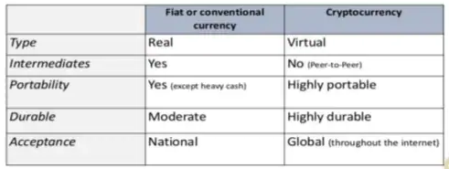
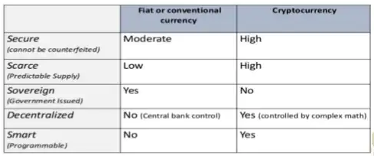
Conventional VS Digital Currency

Slide 5
Why use Cryptocurrency?
Fast, safe and cheap
Ease of use and highly portable
Untraceable
Transparent & neutral
Decentralized nature
Active involvement of user
Fewer risks for merchants
Freedom to transact
Low inflation and collapse risk

Slide 6
Cryptocurrency Security
The aspects of cryptocurrency storage that make them prone to human error are also what make them in danger of hacking and other security breaches. In August 2021, for example, $600 million (£433 million) in crypto assets were stolen when the Blockchain site Poly Network was hacked. Digital crypto wallets, such as mobile and desktop apps, are also called ‘hot wallets’. This means that, while they are easily accessible as they are stored online and are heavily encrypted, the internet connection required means they are not 100% safe from hackers.

Slide 7
Cryptocurrency Security
Other forms of crypto wallets are called ‘cold wallets’, and act as offline storage systems. Cold wallets usually come in two forms:
Hardware wallets that can be plugged into your computer, but exist offline
Paper wallets, where you write down the private key and public address of your crypto wallet.
Both forms of cold wallet, however, carry the risk of being lost or damaged, meaning you will lose your crypto assets forever if you do not have a back-up. It is recommended that, if you are to invest in cryptocurrencies, you use hot and cold wallets in tandem.

Slide 8
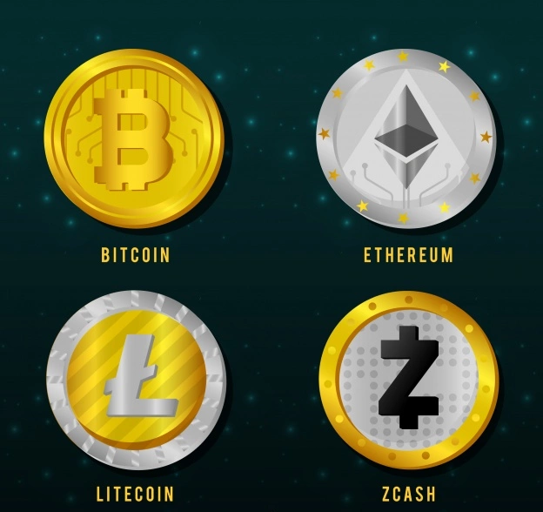
Types of Cryptocurrency
There are many cryptocurrencies are available here is mentioned four popular cryptocurrencies.
BITCOIN
ETHEREUM
LITECOIN
ZCASH

Slide 9

BITCOIN Technology
Distributed ledger technology
Mining
Mining hardware
Mining software
Blockchain
Bitcoin wallets

Slide 10
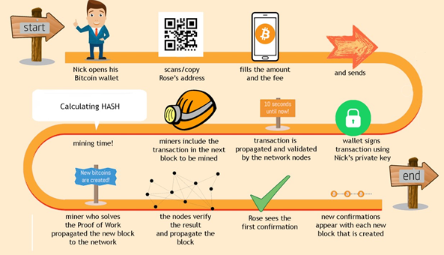
BITCOIN Transaction Process

Slide 11
Conclusion
As crypto matures, we will achieve a lot of stability which will make it easily transferable, and a store of value that will make it more used by businesses, the government, and everyone as a part of everyday life. Cryptocurrency is still a lot in its early stages and some people are still skeptical about it but it is here to stay and has been adapted into our lives and will be a currency used by everyone which is only a matter of time. With the acceptance and how widely talked about it is, the future of crypto is sure to be bright.

Slide 12
THANK YOU !!

